Slide 1

Sentiment Analysis of Company Reviews

Slide 2
USER STORY
To perform sentiment analysis on company reviews

Slide 3
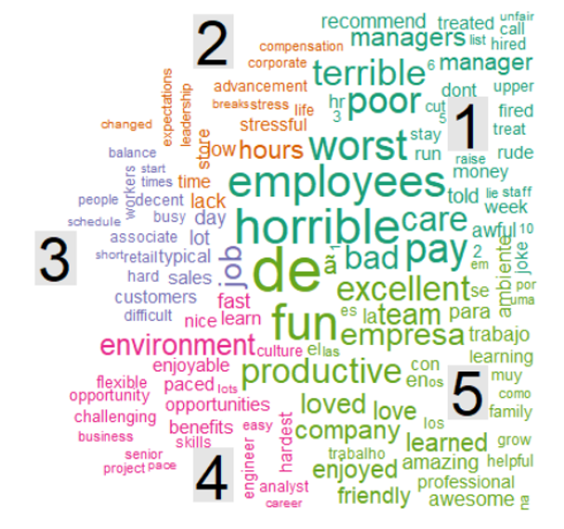
What is Sentiment Analysis?
It is the process of determining whether the piece of information is positive, negative or neutral.

Slide 4
CLASSIFICATION OF DATA
UNSTRUCTURED DATA
It is information that either does not have a pre-defined data model or is not organized in a pre defined manner.
Unstructured information is typically text-heavy, but may contain data such as dates, numbers, and facts as well.
E.g.: include e-mail messages, word processing documents, videos, photos, audio files, presentations, webpages and many other kinds of business documents.
STRUCTURED DATA
Structured data refers to information with a high degree of organization, such that inclusion in a relational database is seamless and readily searchable by simple, straightforward search engine algorithms or other search operations
E.g. numbers, dates, and groups of words and numbers called strings

Slide 5
DATA
(STRUCTURED & UNSTRUCTURED)
CLEAN THE DATA
CCONVERTING THE DATA TO ANOTHER FORM
GETTING CLEANED DATA

Slide 6
IMPLEMENTATION
USING DICTIONARY (AFFIN 111)
E.g. I like the company but it has worst HR policies. The seniors are helpful.
like= +4
worst= -3
helpful= +4
Overall Score = 4-3+4= +5( Positive )

Slide 7
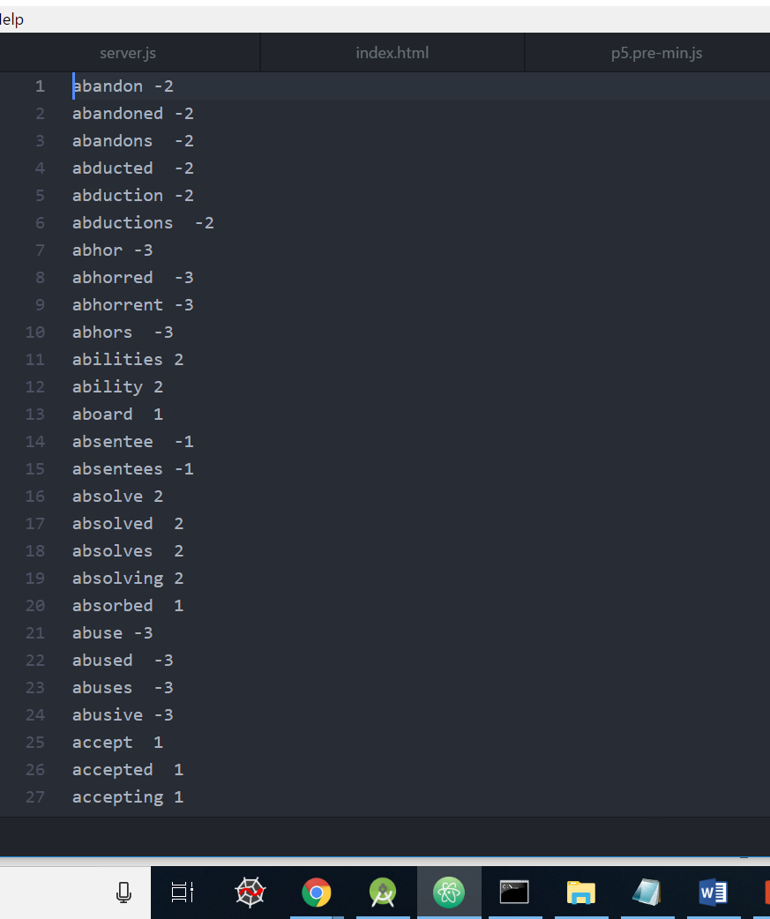
Figure 1: AFFIN DICTIONARY

Slide 8
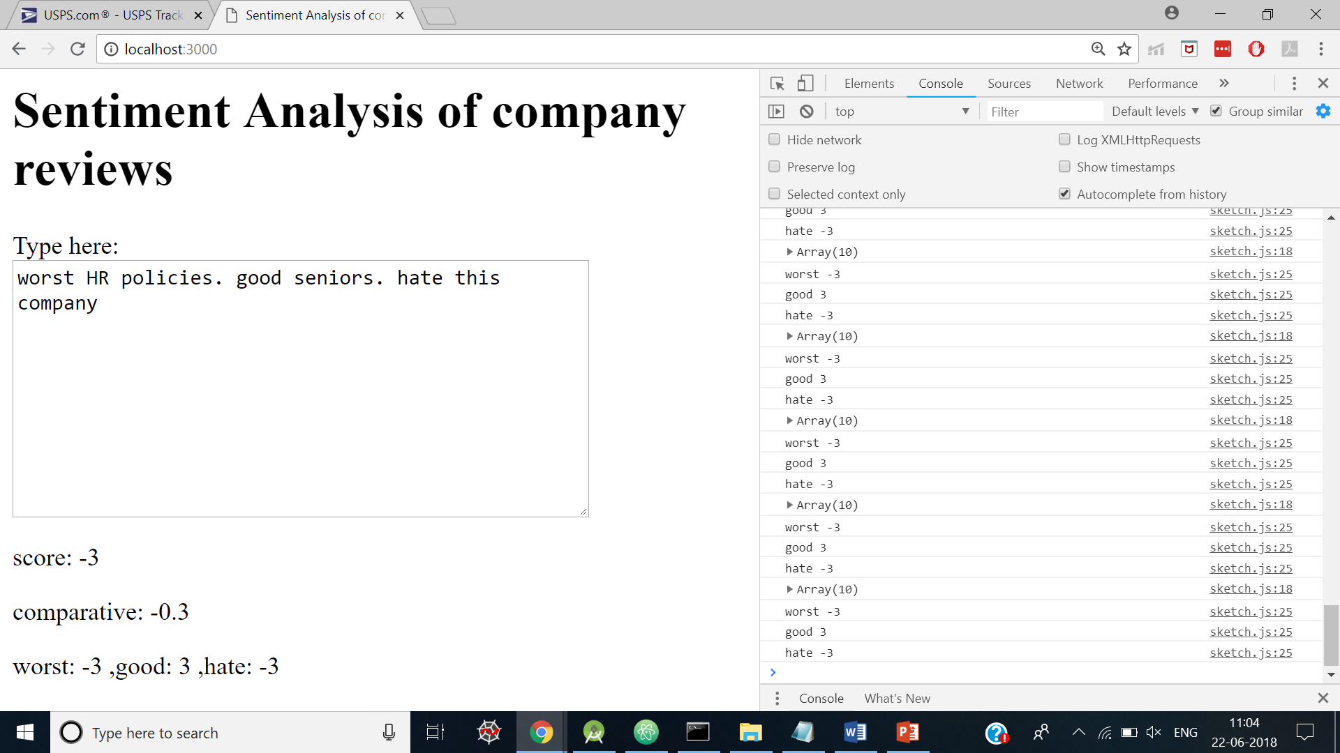
Figure2. Sentiment Analysis of company reviews

Slide 9
THANK YOU

